Slide 1
Fruition Technologies

Slide 2
Project Overview

Slide 3
MODEL RESEARCH

Slide 4
AI Model Research
Objective: Identify the optimal AI model for real-time Canadian Geese detection to trigger a laser deterrent
YOLOv11-Nano
RF-DETR
EfficientDet-D0
Edge AI Speedster
Transformer Precision
Balanced Performer
Grid-based detection optimized for edge hardware. Ultra-fast single-shot detection (<10ms). Best for open environments.
Processes entire image for global context. Excels in cluttered environments (tall grass). Eliminates post-processing latency.
Google's BiFPN architecture balances speed + precision. Detects small targets (goose head at 50m+). Ideal for varied distances.
Fastest
Most Accurate
Best Balance
Also evaluated: Hybrid (Motion + AWS Bedrock), SSD Single Shot

Slide 5


AI Model Recommendation
Primary: Open Field / Close Range
YOLOv11-Nano
Unmatched real-time speed on edge hardware. Sub-10ms response time ensures immediate laser trigger. Designed for low-power devices like the Jetson Orin Nano.
Ultra-fast (<10ms) – best for active deterrence
Runs natively on edge hardware
Easy to fine-tune with custom goose data
Lower accuracy on tiny distant targets
Needs 500+ action shot training images
Alternative: Long Distance / Complex Terrain
EfficientDet-D0
Google's BiFPN architecture simultaneously detects fine details (goose head at 50m) and large shapes. Ideal for lakefront or long-range deployments.
High precision at 50m+ distances
Handles partial visibility & varied terrain
Strong balance of speed and accuracy
Requires model quantization for edge speed
More complex setup than YOLO
Note: RF-DETR excels in marshy/cluttered environments but requires more compute. Recommend evaluating if geese hide in tall grass.

Slide 6
HARDWARE RESEARCH

Slide 7
Hardware Research
Objective: Select hardware capable of real-time AI inference for geese detection at multiple distances
Real-Time Inference
Power Efficiency
Cost Efficiency
Deployment Suitability
Camera Compatibility
Computing Platform Options
NVIDIA DGX Spark
Not Recommended
NVIDIA Jetson Orin Nano Super
Recommended
Designed for large AI workloads. High memory and scalability.
Purpose-built AI edge kit with real-time inference and camera integration.
Handles large AI models easily
Built for real-time AI inference
Easier model development & fine-tuning
Power efficient & compact
Extremely high cost
Good scalability for deployment
Excessive power consumption
Limited RAM (not ideal for very large models)
Overkill for this project scope
Higher cost vs generic boards

Slide 8


Hardware Recommendation
Computing Platform
NVIDIA Jetson Orin Nano Super Dev Kit
Real-time inference optimized for AI Object Tracking
Purpose-built for real-time AI inference with live camera feeds. Power efficient and deployable in field settings. Sufficient performance for YOLOv11-Nano and EfficientDet-D0 within project scope.
Low power draw – suitable for field/battery deployment
Cost-effective vs. DGX Spark at ~$250
RAM limited to smaller model sizes
Alt: NVIDIA DGX Spark — too costly & power-hungry for this use case
Camera
Raspberry Pi HQ Camera
Multiple lens options for varying detection distances
Interchangeable lens system handles both close-range and long-distance detection. High-res sensor captures small targets (geese) in varying lighting conditions.
High resolution for small target detection
Good performance in low-light conditions
Higher resolution increases compute load
Alt: IMX219 Module — viable if budget is constrained, but limited lens options
Recommended Stack: NVIDIA Jetson Orin Nano Super + Raspberry Pi HQ Camera → Paired with YOLOv11-Nano (primary) or EfficientDet-D0 (long range)

Slide 9
MODEL TRAINING

Slide 10
Teaching the AI to Recognize Geese
HOW IT WAS TRAINED
THE RESULTS
Gathered thousands of real goose photos and labeled each one
97.1%
Preliminary result — laptop test, batch size: 8
The AI studied the images in repeated rounds, correcting its own mistakes each time
After 50 rounds of practice, accuracy climbed from 35% to 97%
92.3%
When it says goose — right 92% of the time
WHAT'S NEXT
95.3%
Finds 95 out of every 100 geese in an image
Tested on a standard laptop — batches of 8 images, a deliberate low-resource starting point
Jetson Nano will deliver significantly better accuracy — larger batches, faster processing, and purpose-built for AI in the field
Initial Test Results
Laptop • Batch size: 8 images
⚡ Jetson Nano → expect much better accuracy
Built with YOLOv11s — trained to detect geese accurately and reliably in real-world conditions.

Slide 11
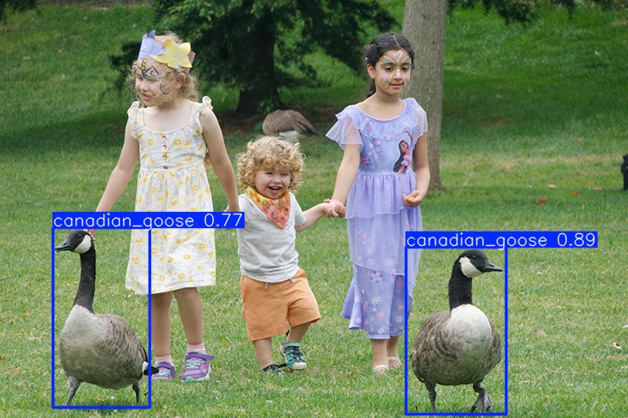
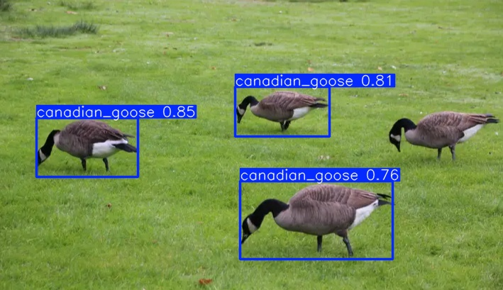
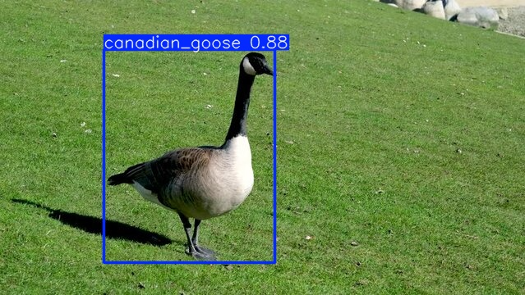
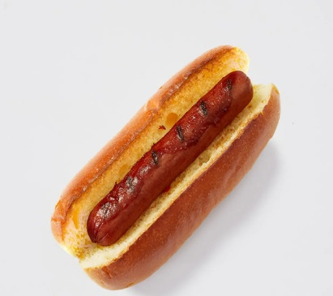
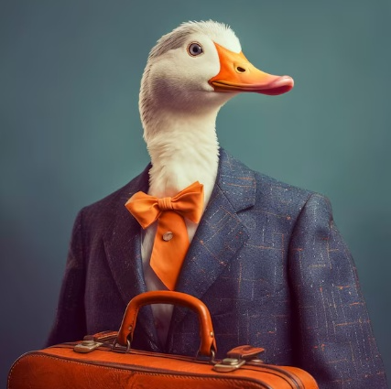
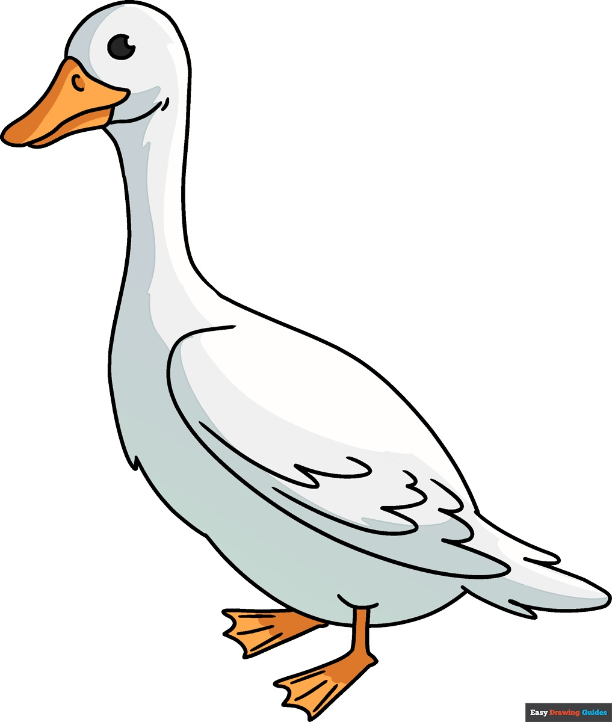
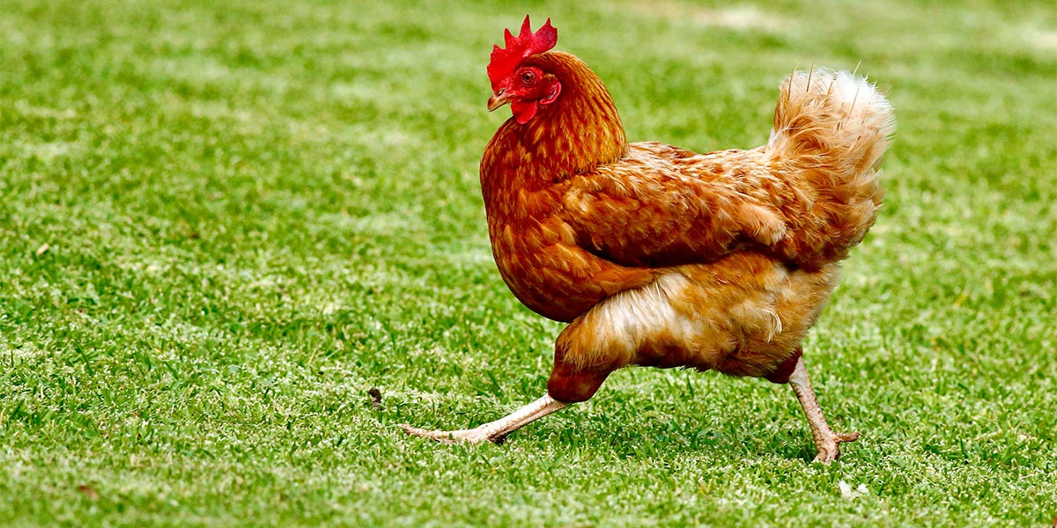
The AI in Action
✅ Geese spotted among people
✅ Single goose detected
✅ Multiple geese detected
❌ Not a goose — correctly ignored
❌ Not a goose — correctly ignored
❌ Not a goose — correctly ignored
The model correctly identifies geese in a variety of real-world situations — and knows what isn’t one.
Image examples demonstrating model detection accuracy

Slide 12
Detecting Geese in Real Time
▶ Video Placeholder
Insert embedded video here
Detects and tracks geese frame by frame as they move
Draws a live bounding box around each goose on screen
Handles multiple geese at once without confusion
From still images to live video — the AI works in real time.
Real-time goose detection using YOLOv11s object detection model

Slide 13
Teaching the AI to Recognize Geese
1 — Where the Data Came From
2 — How Training Worked
3 — How We Verified It Worked
Thousands of real goose photos collected from multiple sources
Each photo manually labeled — a box drawn around every goose
Non-goose images included (people, chickens, hotdogs) so the AI learns what is NOT a goose
Why this matters:
A model only trained on geese will flag everything as a goose. Showing it other objects teaches it the difference.
Step 1 — AI looks at a labeled image and makes a guess
Tested on images the model had never seen before
Recall: how often it correctly found geese
Precision: how often detections were actually geese
Final results validated against a held-out test set, separate from training data
Step 2 — It checks how wrong it was and adjusts itself
Step 3 — Repeated 50 times across the whole dataset (50 epochs)
What is an epoch?
One full pass through all training images — like one complete study session
Data collection → labeling → iterative training → validation — how the model learned to spot a goose.

